Slide 1
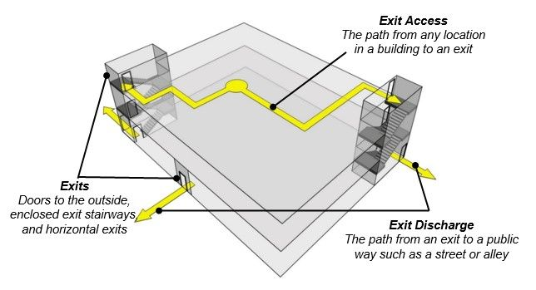
IBC 2018 IBC CHAPTER 10 – MEANS OF EGRESS
ORB University
Means of Egress: “Continuous and unobstructed way of egress travel from any point in a building or facility that provides an accessible route to an area of refuge, a horizontal exit, or a public way”
EXIT ACCESS
EXIT
EXIT DISCHARGE

Slide 2
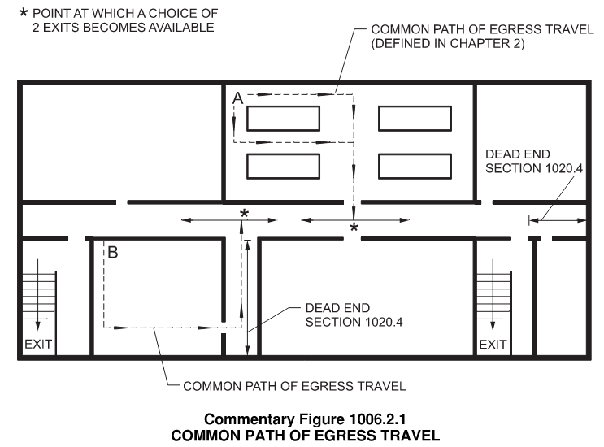
IBC SECTION 1006
1006 NUMBER OF EXITS AND EXIT ACCESS DOORWAYS
Exit: “That portion of a means of egress system between the exit access and the exit discharge or public way. Exit components include exterior exit doors at the level of exit discharge, interior exit stairways and ramps, exit passageways, exterior exit stairways and ramps and horizontal exits.”
Exit access doorway: “A door or access point along the path of egress travel from an occupied room, area or space where the path of egress enters an intervening room, corridor, exit access stairway or ramp”.
Minimum number of paths of travel an occupant have available to avoid a fire incident in the occupied room or space.
What’s the intent?
To determine the number of ways out of a space or off a floor, either by exit elements or exit access elements, based on the level of risk
COMMON PATH OF EGRESS TRAVEL.
That portion of exit access travel distance measured from the most remote point of each room, area or space to that point where the occupants have separate and distinct access to two exits or exit access doorways.

Slide 3
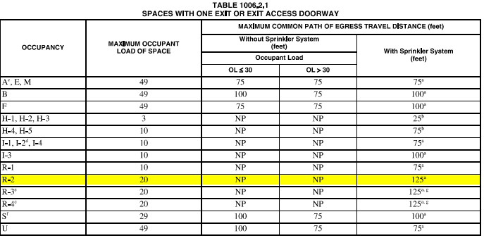
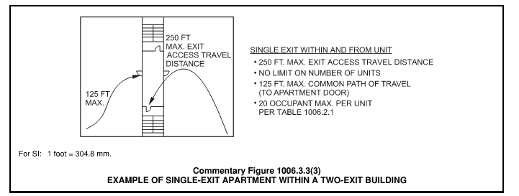
What do we need to know?
Occupancy - Level of hazard
Occupant loads - # of occupants at risk. Always round up!
Sprinkler system *
Travel distance to a doorway
Maximum occupants allowed for one exit Table 1006.2.1
*Per note a)
Travel distance increase is based on an NFPA 13 or NFPA 13R sprinkler system
Considerations:
Interior door swing allowed when less than 50 occupants.
Panic hardware not require when less than 50 occupants.
1006.2.1 Two exit or exit access doorways shall be provided when exceeding table 1006.2.1

Slide 4
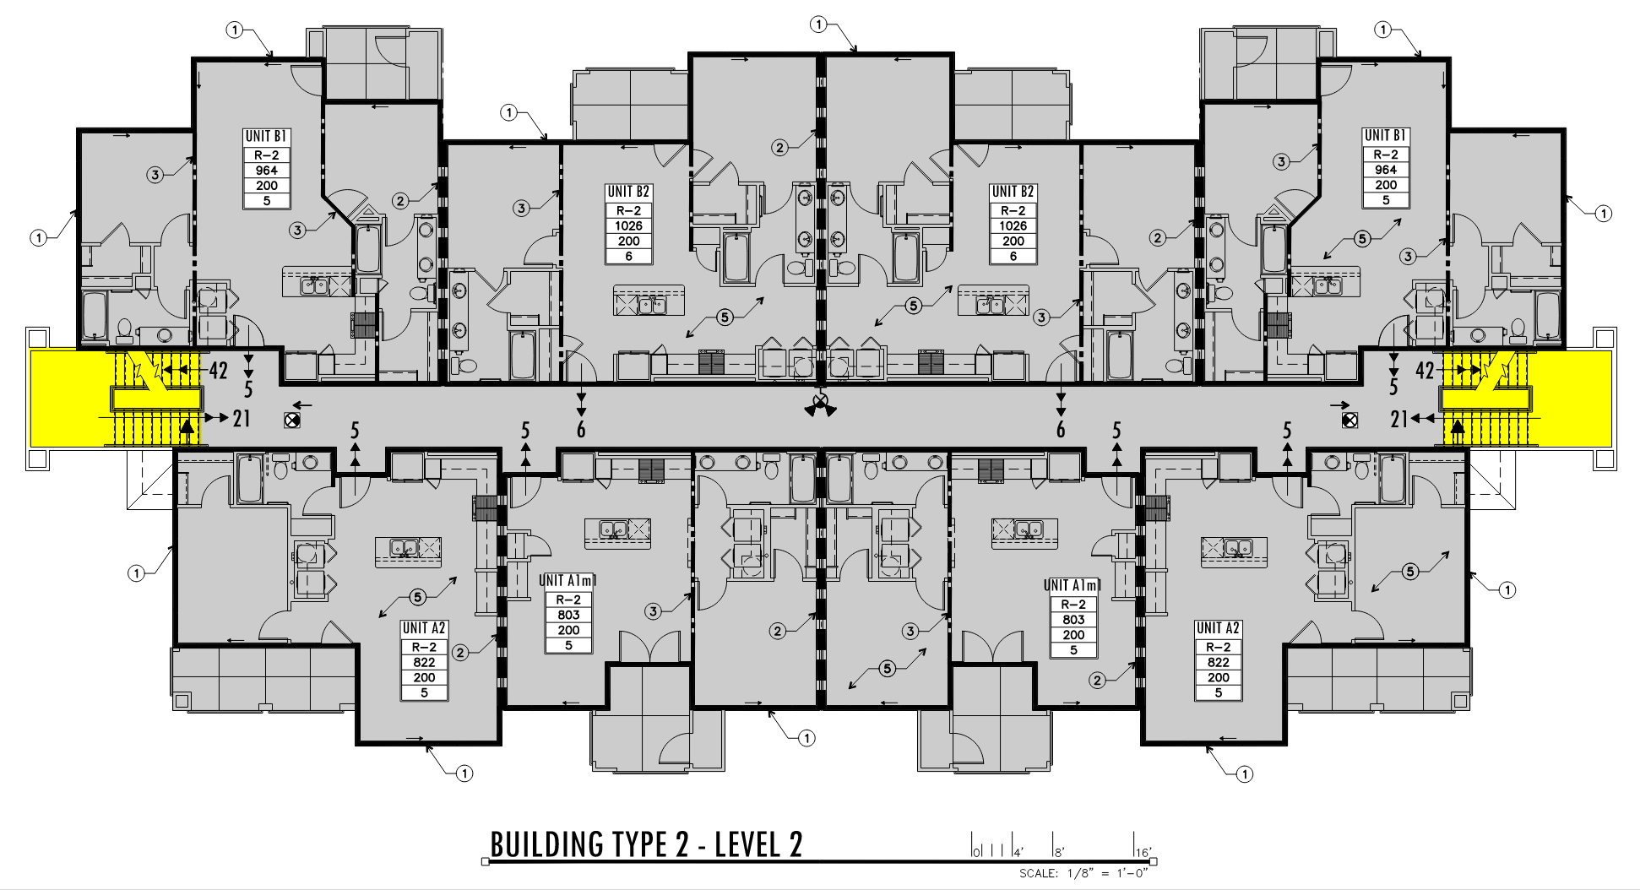
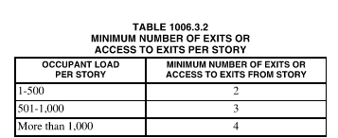
Also
1006.3 Egress from stories or occupied roofs The means of egress system serving any story or occupied roof shall be provided with the number of separate and distinct exits or access to exits based on the aggregate occupant load served in accordance with this section.
Where stairways serve more than one story, only the occupant load of each story considered individually shall be used in calculating the required number of exits or access to exits serving that story
1006.3.3(1) Applicable for Garden projects
Considerations:
1006.2.1.1 Three or more exits or exit access doorways required for an occupant load of 501 to 100 occupants.
1006.2.1.1 Four exits or exit access doorways required for an occupant load of +1000 occupants.
Vehicular ramps shall not be considered an exit access ramp unless pedestrian facilities are provided

Slide 5
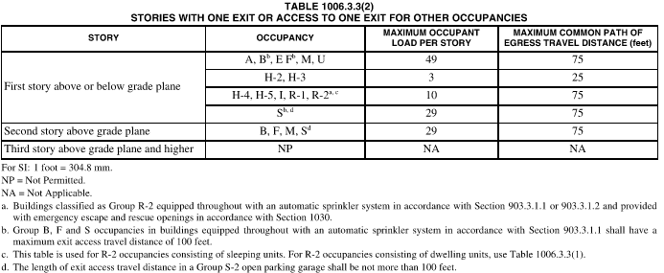
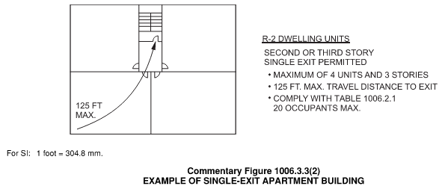
Also
1006.3.3 Single exits from any story or occupied roof are allowed when:
1. Occupant load, number of dwelling units and common path of egress distance does not exceed Table 1006.3.3.(1) or 1006.3.3.(2)
5. Individual single story or multi-story are allowed to have one exit when complying with table 1006.2.1 and the exit of the dwelling unit discharges directly to the exterior at level of exit discharge, or the exit access outside the dwelling unit provides not less than 2 independent exits.
Where stairways serve more than one story, only the occupant load of each story considered individually shall be used in calculating the required number of exits or access to exits serving that story

Slide 6
IBC 2018 SECTION 1009
ORB University
ACCESSIBLE MEANS OF EGRESS
1009.1 Accessible spaces shall be provided with not less than one accessible means of egress. Where more than one means of egress is required by Section 1006.2 or 1006.3 from any accessible space, each accessible portion of the space shall be served by not less than two accessible means of egress.
ACCESSIBLE: A site, building, facility or portion thereof that complies with Chapter 11 – ACCESSIBILITY
What’s the intent?
To evacuate people with mobility impairments, to self-evacuate or to arrange for assisted rescue.

Slide 7
IBC SECTION 1009
1009.2 Continuity and components.
Each required accessible means of egress shall be continuous to a public way and shall consist of one or more of the following components:
Accessible routes complying with Section 1104.
Interior exit stairways complying with Sections 1009.3 and 1023.
Exit access stairways complying with Sections 1009.3 and 1019.3 or 1019.4.
Exterior exit stairways complying with Sections 1009.3 and 1027 and serving levels other than the level of exit discharge.
Elevators complying with Section 1009.4.
Platform lifts complying with Section 1009.5.
Horizontal exits complying with Section 1026.
Ramps complying with Section 1012.
Areas of refuge complying with Section 1009.6.
Exterior areas for assisted rescue complying with Section 1009.7 serving exits at the level of exit discharge.

Slide 8
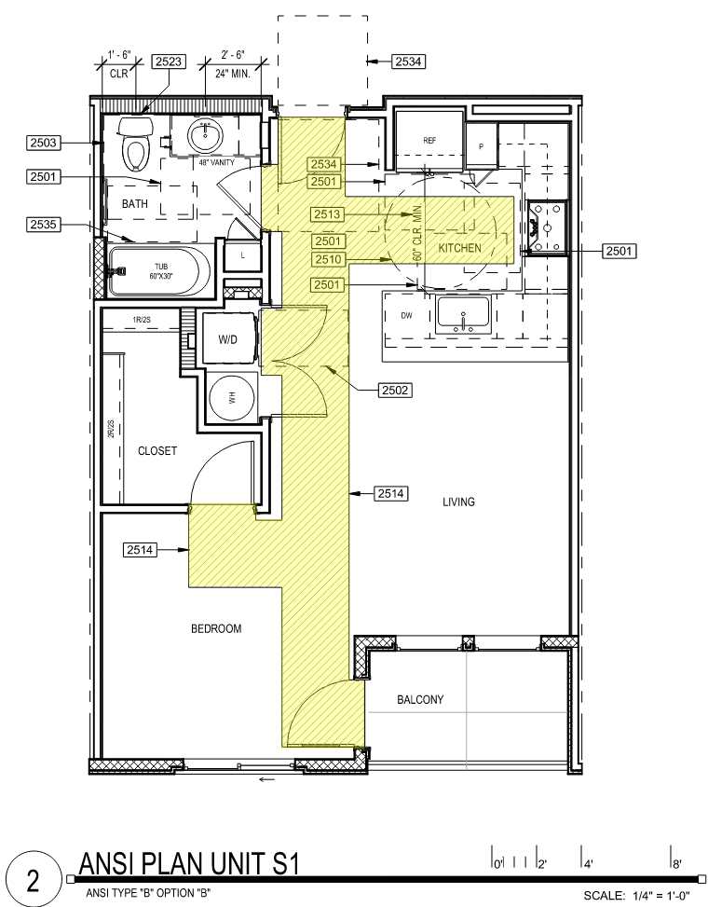
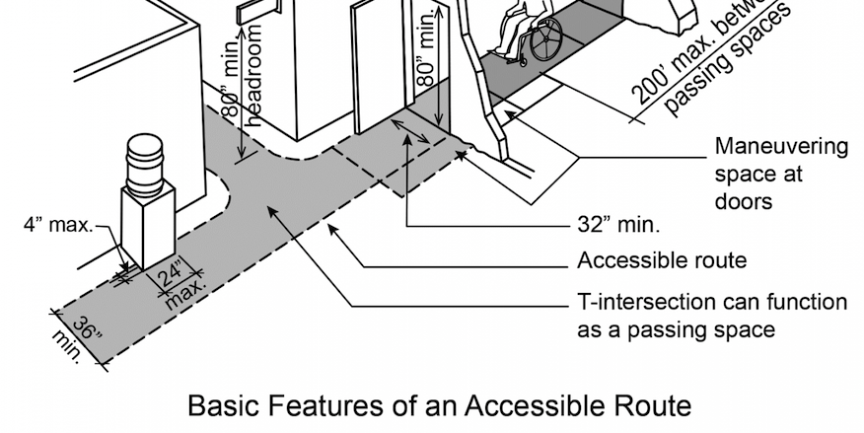
1. ACCESSIBLE ROUTES
“A continuous, unobstructed path that complies with Chapter 11”.
Is this an accessible route?
Examples

Slide 9
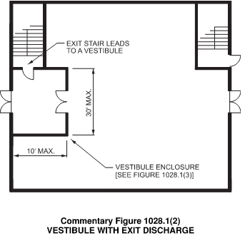
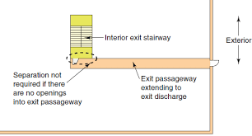
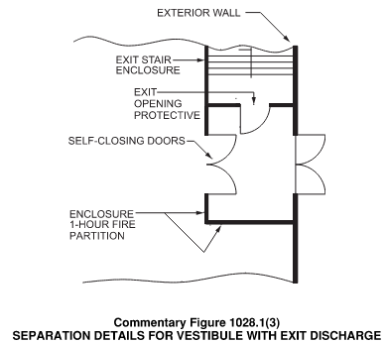
2. INTERIOR EXIT STAIRWAYS
“An exit component that serves to meet one or more means of egress design requirements, such as required number of exits or exit access travel distance and provides for a protected path of egress travel to the exit discharge or public way.”
1023 Required to be enclosed.
1024 Exit passageways are considered an extension of the exit enclosure. Used as means of egress and circulation path
Considerations:
1023.2 2-Hr Fire rating min. when connecting 4-Stories
1023.2 2-Hr Fire rating min. when connecting 3 or less stories
Opening protectives
Travel distance
Signage
1028.1 Exception 1.1 Discharge of interior exit stairways and ramps shall be provided with a free and unobstructed path of travel to an exterior exit door and such exit readily visible and identifiable from the point of termination of the enclosure
Refer to IBC Section 1023 & 1028

Slide 10
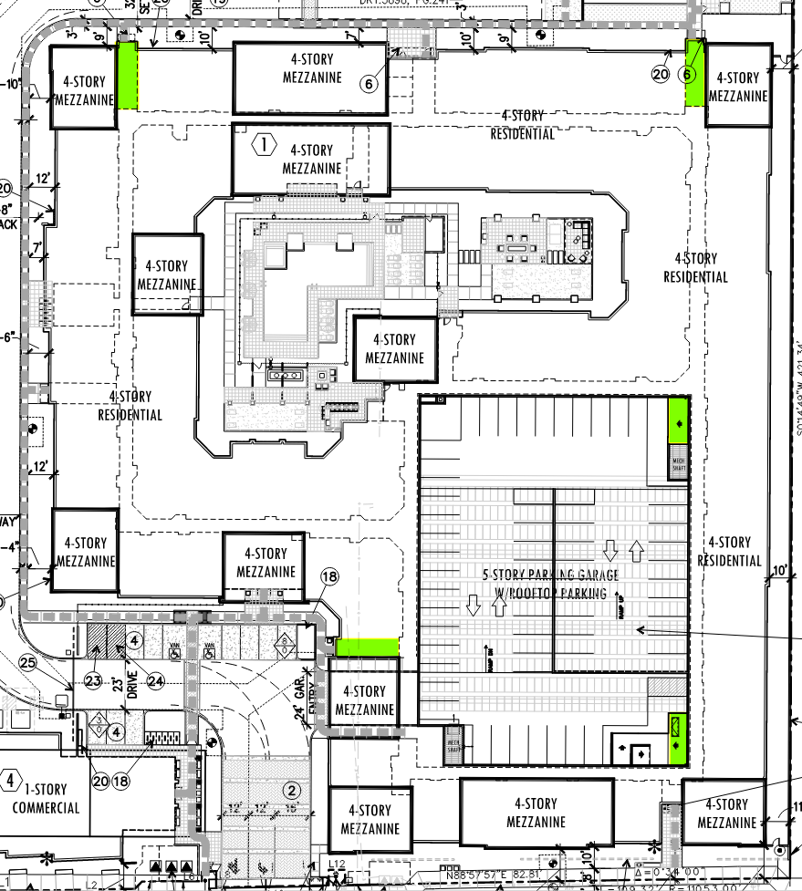
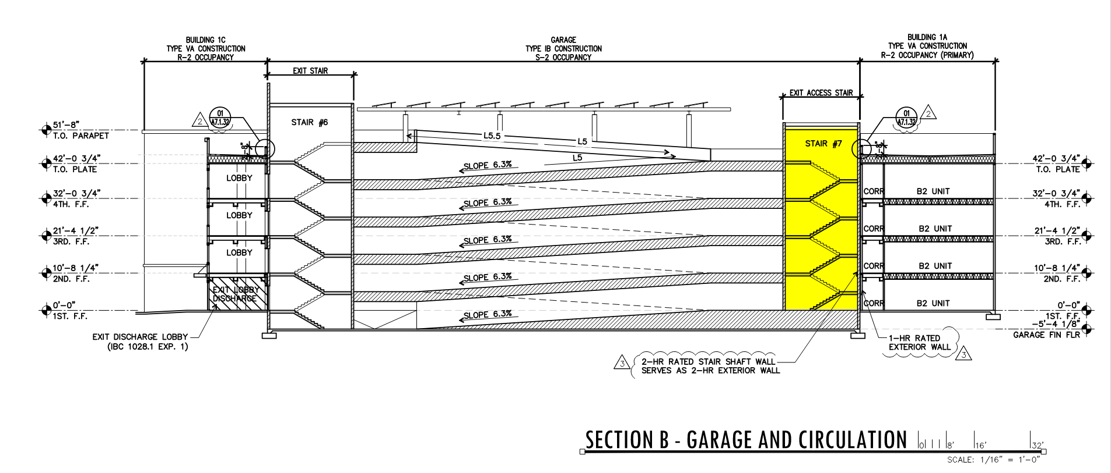
3. EXIT ACCESS STAIRWAYS
“A stairway within the exit access portion of the means of egress system”
1019 Includes basements but not mezzanines
1019.3 Open stairways between stories
Protected path of egress between an exit access and the exit discharge.
Refer to IBC Section 1019

Slide 11
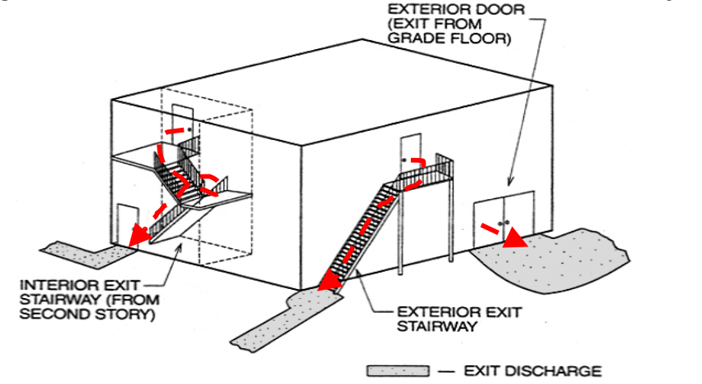
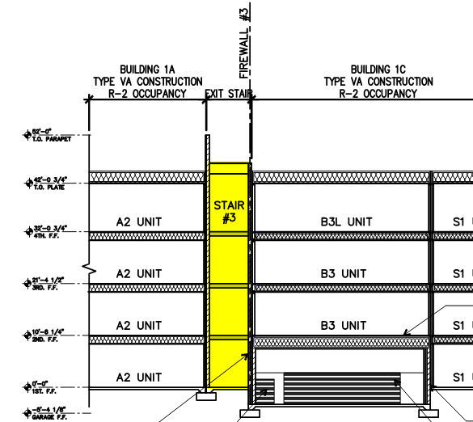
4. EXITERIOR EXIT STAIRWAYS
“A stairway within the exit access portion of the means of egress system”
Provides protected path of egress between exit access and exit discharge.
Stair protected by the exterior wall of the building
Refer to IBC Section 1027

Slide 12
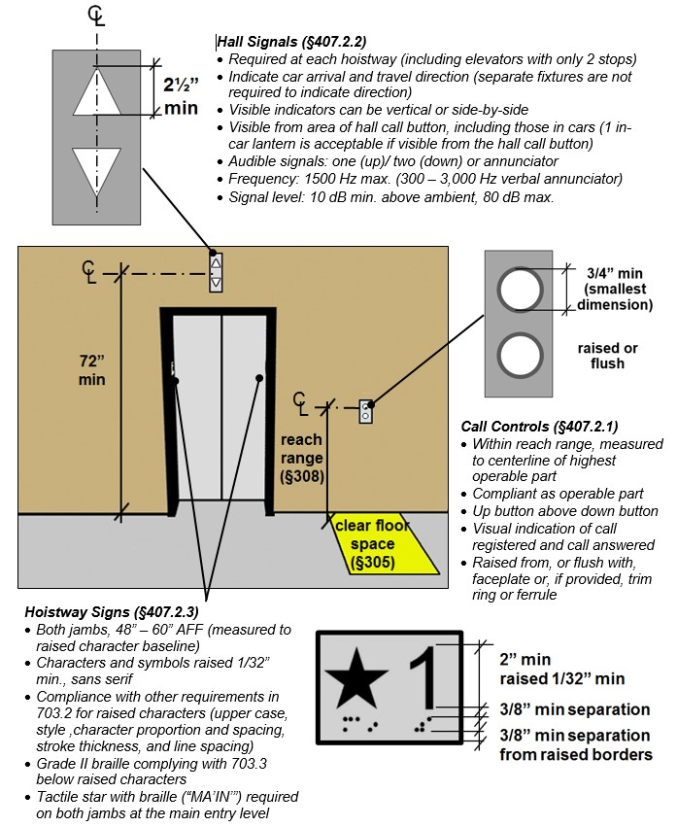
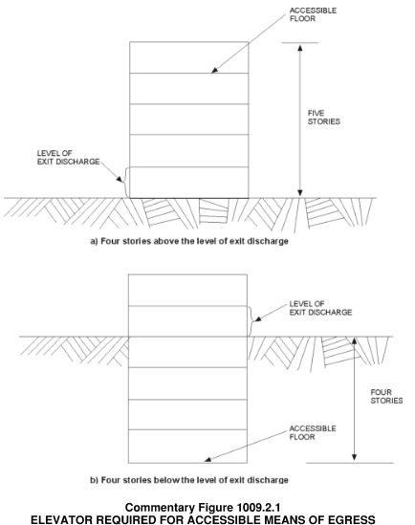
5. ELEVATORS
1009.2.1 Elevators required. P
In buildings where a required accessible floor is four or more stories above or below a level of exit discharge, not less than one required accessible means of egress shall be an elevator complying with Section 1009.4.
Exception 1.
What do we know?
Elevators are not intended to be for self-evacuation
1009.4.2 Area of refuge and 1009.4.1 standby power is required.
1009.8 Two-way communication system required at the landings on each accessible floor that is one or more stories above or below the level of exit discharge
3006.3 Hoistway opening protection by Elevator lobbies 3007.6.2 or Smoke curtains (Not required at level of exit discharge)
Refer to IBC Section 1009, 3006

Slide 13
7. HORIZONTAL EXITS
“An exit component consisting of fire-resistance-rated construction and opening protectives intended to compartmentalize portions of a building thereby creating refuge areas that afford safety from the fire and smoke from the area of fire origin”
What do we know?
Serve as an exit
1026.2 2-Hr rated Minimum Fire walls, fire barriers or horizontal assemblies Opening protectives
1026.3 Opening protectives
1026.4 Refuge area meant to hold occupants temporarily
Refer to IBC Section 1026

Slide 14
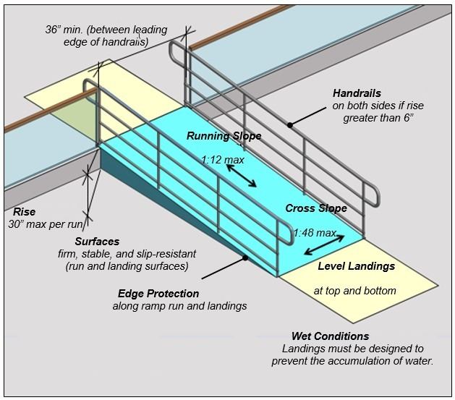
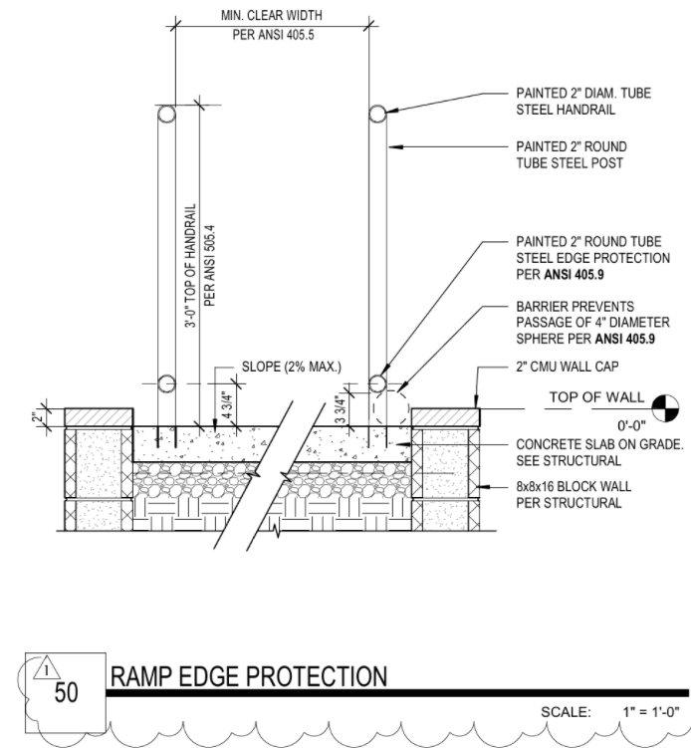
8. RAMPS
”A walking surface that has a running slope steeper than one unit vertical in 20 units horizontal (5-percent slope)”
1003.5 Elevation change.
Where changes in elevation of less than 12” exist in the means of egress, sloped surfaces shall be used. Where the difference in elevation is 6 inches (152 mm) or less, the ramp shall be equipped with either handrails or floor finish materials that contrast with adjacent floor finish materials.
What do we know?
1012.8 Handrails required when rise is +6”
1012.4 Vertical rise 30” max.
1012.5.1 36” Min. width between handrails
1012.6 60” Min. Landings required at: Top and bottom, turning points, entrance, exits and at doors.
1012.10 Edge protection required
1012.5.2 Headroom 80” Min.
Refer to IBC Section 1012

Slide 15
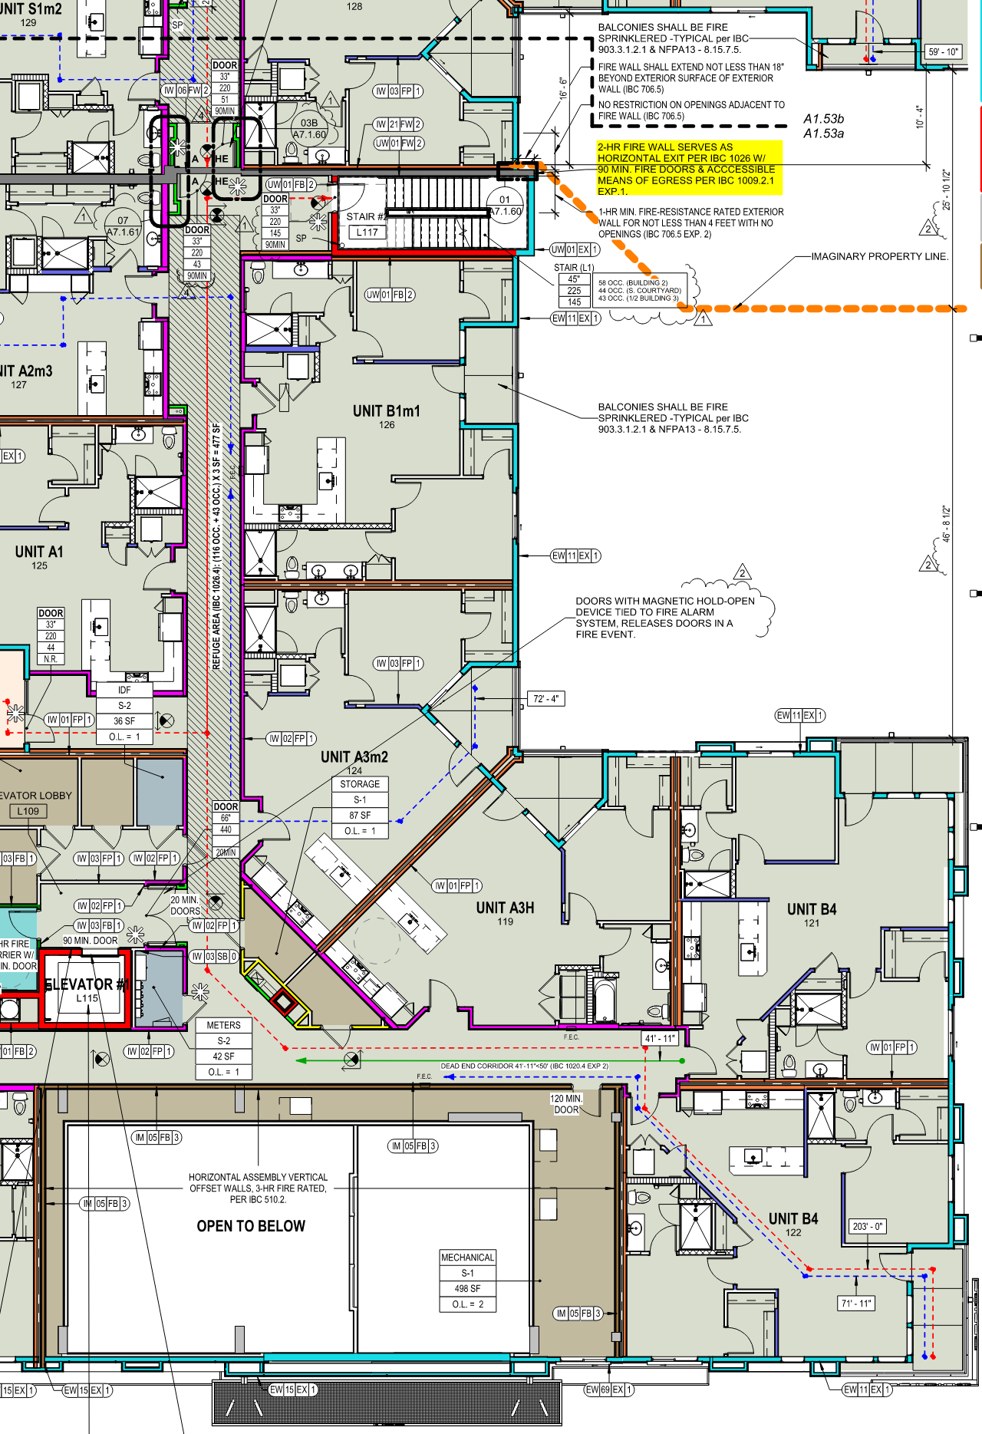
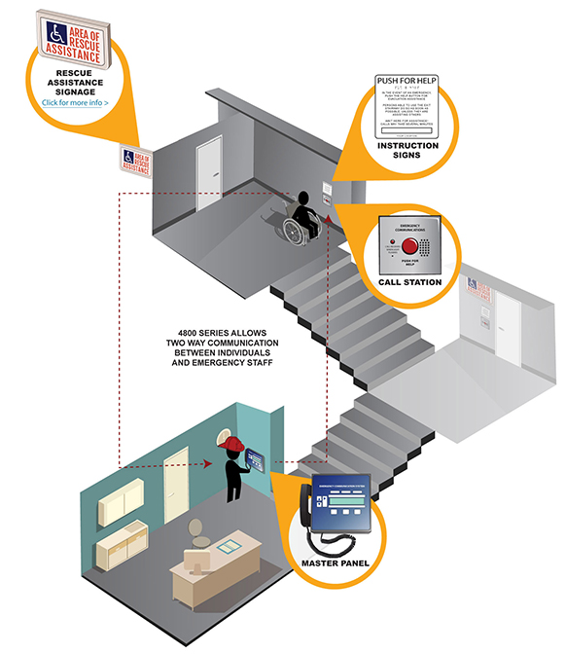
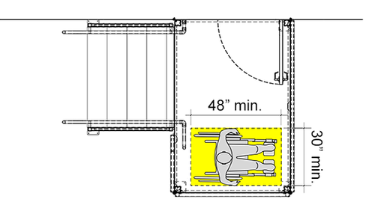
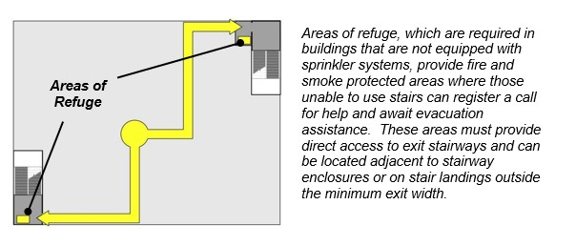
9. AREAS OF REFUGE
“An area where persons unable to use stairways can remain temporarily to await instructions or assistance during emergency evacuation.”
What do we know?
Every required area of refuge shall have direct access to a stairway complying with Sections 1009.3 and 1023 or an elevator complying with Section 1009.4

Slide 16
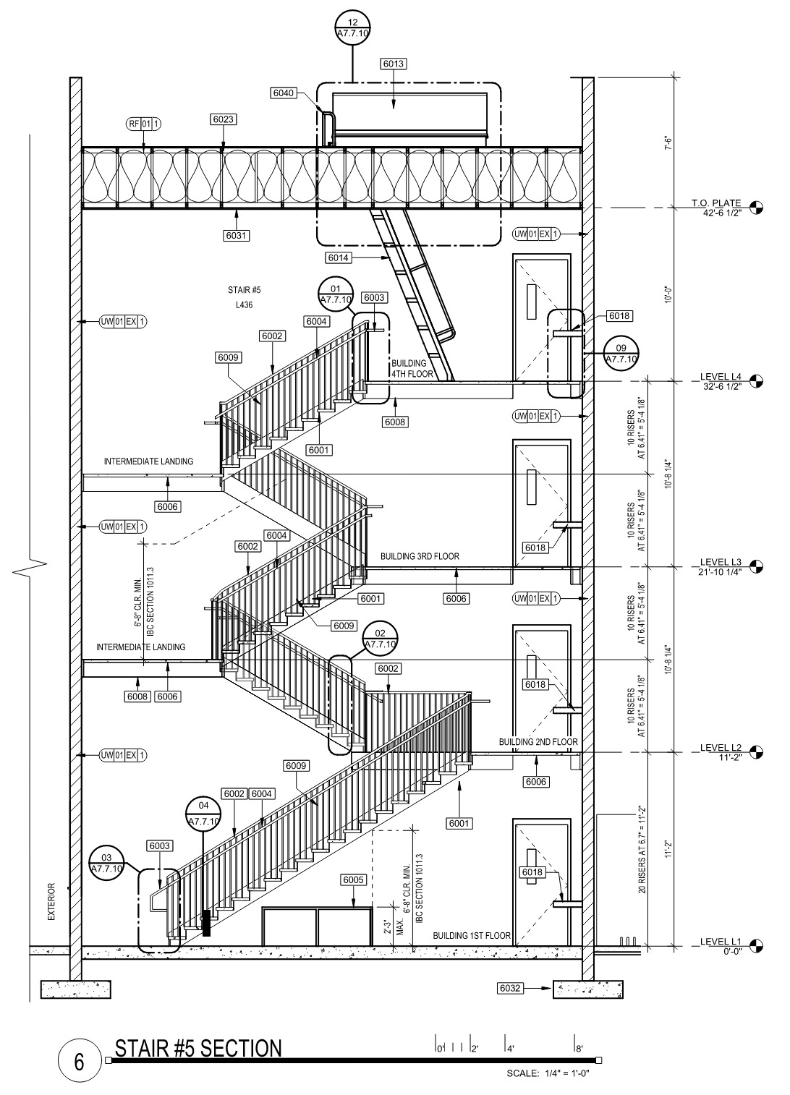
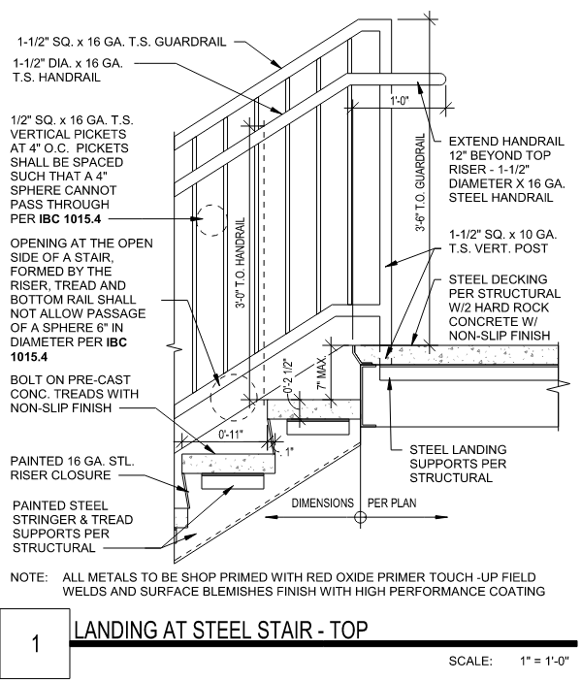
CHAPTER 1011 STAIRWAYS
1009.3 Stairways
While not part of an accessible route can be part of accessible means of egress when used as part of an assisted evacuation route.
Components.
1011.2 Min. width and capacity 44” Min.
1011.2(1) Occupancy less than 50 allows for 36” wide stairs
1011.3 Headroom 80” Min. and vertical barriers
1011.5.2 Risers 7” max. and 4” Min; 11” Min. tread depth.
1011.5(3) 7-3/4” max allowed within dwelling units R-2 and U occupancies
1011.6 Stair landings 44” Min. width
1014 Handrails at 34”-38” AF.F.F. ORB 36”
1015 Guardrails at 42” AF.F.F.
No protrusions are allowed into Maneuvering door clearances

Slide 17
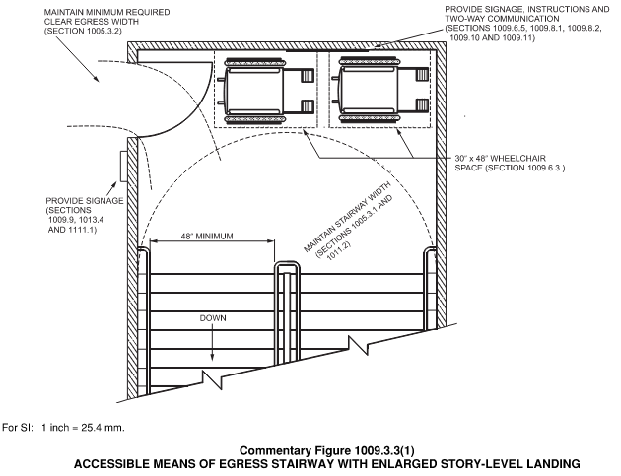
Also.
1009.3.3 (1). Areas of refuge are not required at stairways in buildings equipped with a two-way communication system
1009.3.3 (5). Areas of refuge are not required in Group R-2 occupancies or at stairways in buildings equipped with an automatic sprinkler system
1011.12 Stairway shall extend to roof unless 1011.12.1 using an alternating tread device

Slide 18
CHAPTER 10 – MEANS OF EGRESS MEANS OF EGRESS
1004. OCCUPANT LOAD
1005 MEANS OF EGRESS SIZING
1006 NUMBER OF EXTIS AND EXIT ACCESS DOORWAYS
1007 EXIT AND EXIT ACCESS CONFIGURATION
1009 ACCESSIBLE MEANS OF EGRESS
1010 DOORS, GATES AND TURNSTILES
1011 STAIRWAYS
1012 RAMPS
1013 EXIT SIGNS
1014 HANDRAILS
1015 GUARDS

Slide 19
CHAPTER 10 – MEANS OF EGRESS EXIT ACCESS
1016 EXIT ACCESS
1017 EXIT ACCESS TRAVEL DISTANCE
1018 AISLES
1019 EXIT ACCESS STAIRWAYS AND RAMPS
1020 CORRIDORS
1021 BALCONIES

Slide 20
CHAPTER 10 – MEANS OF EGRESS EXITS
1022 EXITS
1023 INTERIOR EXITS STAIRWAYS AMD RAMPS
1024 EXIT PASSAGEWAY
1025 LUMINOUS EGRESS PATH MARKINGS
1026 HORIZONTAL EXITS
1027 EXTERIOR EXIT STAIRWAYS AND RAMPS

Slide 21
CHAPTER 10 – MEANS OF EGRESS EXIT DISCHARGE
1028 EXIT DISCHARGE
1029 ASSEMBLY
1030 EMERGENCY SCAPE AND RESCUE

